Slide 1



Slide 2
Systems Analysis and Design
Chapter 2
Analyzing the Business Case

Slide 3
Chapter Objectives
Explain the concept of a business case and how a business case affects an IT project
Describe the strategic planning process and why it is important to the IT team
Explain the purpose of a mission statement
Conduct a SWOT analysis and describe the four factors involved
Explain how the SDLC serves as a framework for systems development

Slide 4

Chapter Objectives (Cont.)
List reasons for systems projects and factors that affect such projects
Describe systems requests and the role of the systems review committee
Define operational, technical, economic, and schedule feasibility
Describe the steps and the end product of a preliminary investigation

Slide 5
Introduction
The term business case refers to the reasons, or justification, for a proposal
A strong business case suggests that the company should pursue the alternative, above other options, because it would be in the firm’s best interest to do so
Systems development typically starts with a systems request, followed by a preliminary investigation, which includes a feasibility study
Preliminary investigation follows to evaluate:
  Feasibility study
  Fact finding techniques
  Reporting to management

Slide 6
A Framework for IT System Development

Slide 7
A Framework for IT System Development
Strategic Planning
the process of identifying long-term organizational goals, strategies, and resources
looks beyond day-to-day activities and focuses on a horizon that is three, five, ten, or more years in the future
Strategic Planning Overview
Starts with a mission statement
Continues with goals and objectives
Long and short-term goals identified

Slide 8






A Framework for IT System Development
SWOT Analysis
Focus on a specific product or project, an operating division, the entire company, or the mission statement itself.
Aim: to avoid seeking goals that are unrealistic, unprofitable, or unachievable.

Slide 9
A Framework for IT System Development
SWOT Analysis
An enterprise SWOT analysis usually begins with these questions:
  What are our strengths, and how can we use them to achieve our business goals?
  What are our weaknesses, and how can we reduce or eliminate them?
  What are our opportunities, and how do we plan to take advantage of them?
  What are our threats, and how can we assess, manage, and respond to the possible risks?

Slide 10
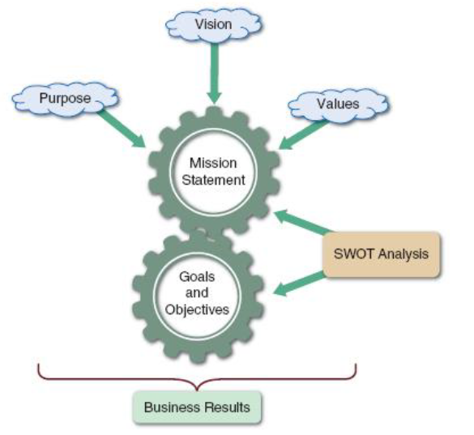
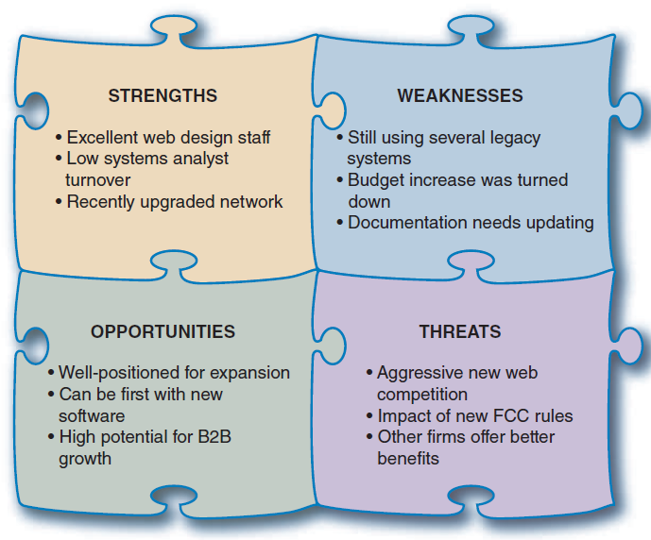
A Framework for IT System Development
SWOT Analysis
FIGURE 2-4 A SWOT analysis might produce similar results to those shown here
FIGURE 2-3 Strategic planning is a dynamic process that starts with a mission statement, which is shaped by the firm’s purpose , vision, and values. The mission generates goals and objectives that produce business results.

Slide 11
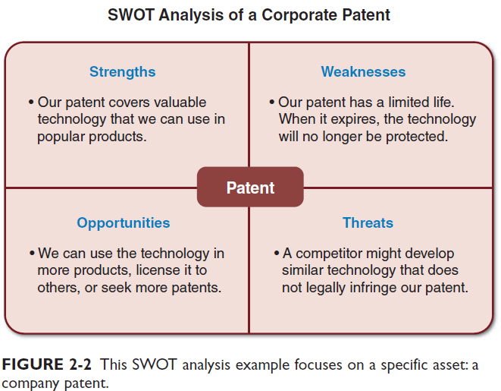

A Framework for IT System Development
SWOT Analysis

Slide 12
A Framework for IT System Development
Strategic Planning for IT Projects
Careful planning can help assure that:
  The project supports overall business strategy and operational needs
  The project scope is well-defined and clearly stated
  The project goals are realistic, achievable, and tied to specific statements, assumptions, constraints, factors, and other inputs

Slide 13
A Framework for IT System Development
Planning Tools
  Some analysts use traditional text-based methods like Microsoft Word
  Some analysts prefer a spreadsheet method like Microsoft Excel
  The most effective approach is to use a CASE tool such as Visible Analyst

Slide 14
A Framework for IT System Development
Planning Tools
  Some analysts use traditional text-based methods like Microsoft Word
  Some analysts prefer a spreadsheet method like Microsoft Excel
  The most effective approach is to use a CASE tool such as Visible Analyst

Slide 15
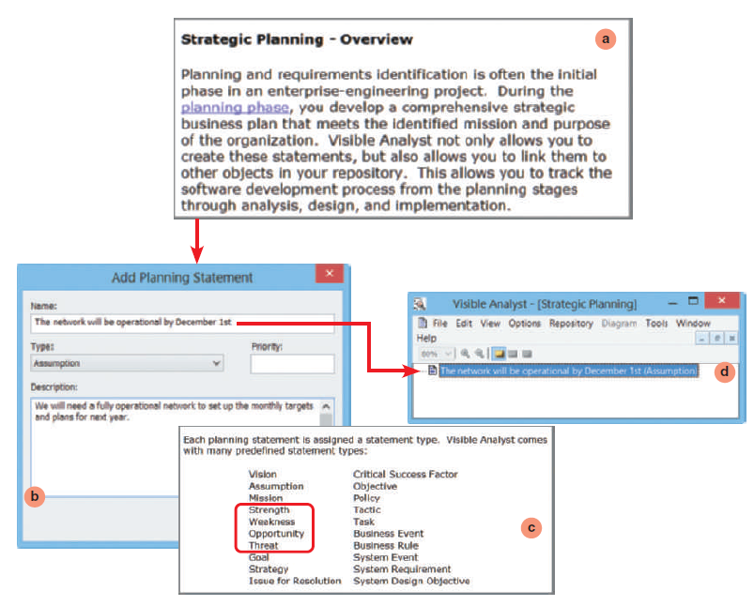
FIGURE 2-3 The Visible Analyst CASE tool supports strategic planning and allows a user to enter many kinds of planning statements. Notice the four SWOT categories highlighted in the list.
Source: Visible Systems Corporation.

Slide 16
A Framework for IT System Development
A New Role for the IT Department
  Management and IT are linked closely, and remarkable changes have occurred in both areas
  Today, systems development is much more team- oriented
  Although team-oriented development is the norm, some companies see the role of the IT department being screening and evaluating systems requests
  Larger firms are more likely to use an evaluation team or systems review committee

Slide 17
What is A Business Case?

Slide 18
What is A Business Case?
A business case refers to the reasons, or justification, for a proposal
  Should be comprehensive, yet easy to understand
  Should describe the project clearly, provide the justification to proceed, and estimate the project’s financial impact

Slide 19
What is A Business Case?
The business case should answer questions such as the following:
  Why are we doing this project?
  What is the project about?
  How does this solution address key business issues?
  How much will it cost and how long will it take?
  Will we suffer a productivity loss during the transition?
  What is the return on investment and payback period?
  What are the risks of doing the project? What are the risks of not doing the project?
  How will we measure success?
  What alternatives exist?

Slide 20
Information Systems Projects

Slide 21
Information Systems Projects
The starting point for most projects is called a systems request, which is a formal way of asking for IT support.
  propose enhancements for an existing system, the correction of problems, the replacement of an older system, or the development of an entirely new information system that is needed to support a company’s current and future business needs.

Slide 22
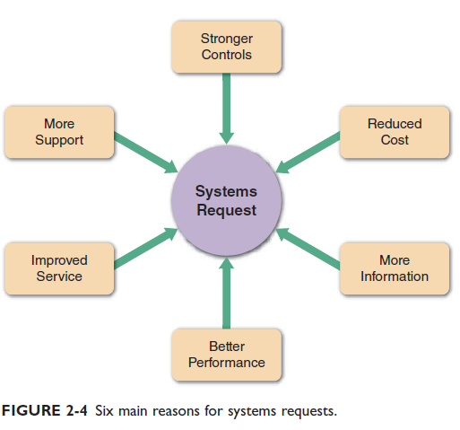



Information Systems Projects
Main reasons for systems request:

Slide 23
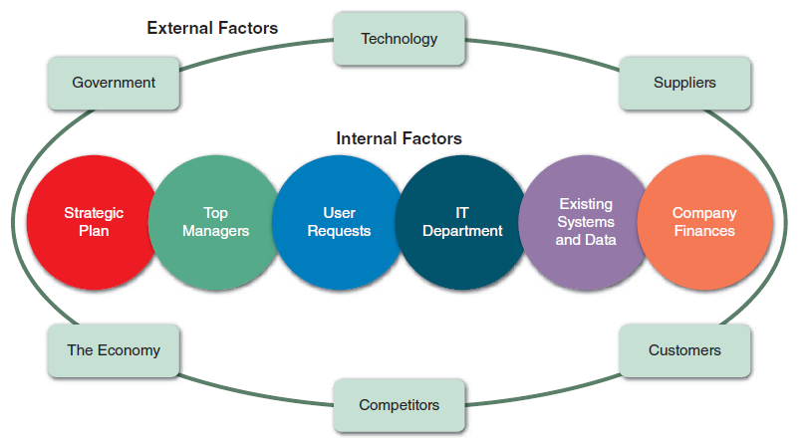


Information Systems Projects
Factors that affect systems projects:
FIGURE 2-6 Internal and external factors that affect IT projects.

Slide 24
Evaluation of Systems Requests

Slide 25
Evaluation of Systems Requests
In most organizations, the IT department receives more systems requests than it can handle.
Many organizations assign responsibility for evaluating systems requests to a group of key managers and users.
  System Review Committees / Computer Resources Committee

Slide 26
Evaluation of Systems Requests
System Request Forms
  Streamlines the request process
  Ensures consistency
  Easy to understand
  Includes clear instructions
  Indicates what supporting documents are needed
  Submitted electronically

Slide 27
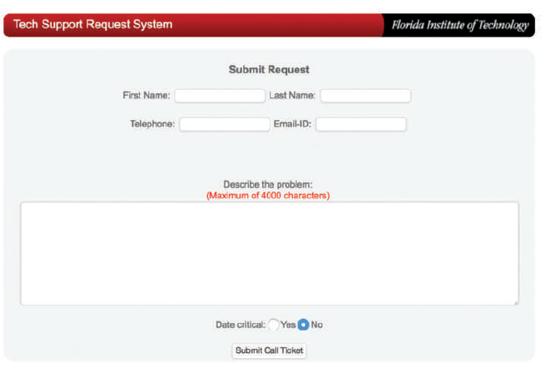
Evaluation of Systems Requests
System Request Forms
FIGURE 2-10 Example of an online systems request form.
Source: Florida Institute of Technology

Slide 28
Evaluation of Systems Requests
System Review Committee
With a broader viewpoint, a committee can establish priorities more effectively than an individual
  The goal is to evaluate the requests and set priorities
One person’s bias is less likely to affect the decisions
Disadvantages:
  Action on requests must wait until the committee meets
  Members might favor projects requested by their own departments
  Internal political differences could delay important decisions

Slide 29
Overview of Feasibility

Slide 30
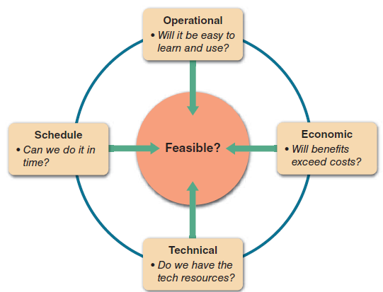
Overview of Feasibility
A systems request must pass several tests, called a feasibility study, to see whether it is worthwhile to proceed further
FIGURE 2-11 A feasibility study examines operational, technical, economic, and schedule factors.

Slide 31
Overview of Feasibility
Feasibility Study: 1: Operational Feasibility
  Means that a proposed system will be used effectively after it has been developed.
  If users have difficulty with a new system, it will not produce the expected benefits.
  Operational feasibility is difficult to measure with precision, but must be studied very carefully as it depends to several issues .

Slide 32
Overview of Feasibility
Feasibility Study: 2: Technical Feasibility
  Refers to the technical resources needed to develop, purchase, install, or operate the system.

Slide 33
Overview of Feasibility
Feasibility Study: 3: Economic Feasibility
  Means that the projected benefits of the proposed system outweigh the estimated costs usually considered the total cost of ownership (TCO), which includes ongoing support and maintenance costs, as well as acquisition costs
  Tangible costs: cost that can be measured in dollars.
  Intangible costs: cost that can not be measured in dollars.
  Tangible benefits: benefits that can be measured in dollars.
  Intangible benefits: benefits that can not be measured in dollars.

Slide 34
Overview of Feasibility
Feasibility Study: 4: Schedule Feasibility
  Means that a project can be implemented in an acceptable time frame.
  When assessing schedule feasibility, a systems analyst must consider the interaction between time and costs.

Slide 35
Evaluating Feasibility

Slide 36
Evaluating Feasibility
The first step in evaluating feasibility is to identify and weed out systems requests that are not feasible
Even if the request is feasible, it might not be necessary
Feasibility analysis is an ongoing task that must be performed throughout the systems development process
  Requests that are not currently feasible can be resubmitted as new hardware, software, or expertise becomes available

Slide 37
Setting Priorities

Slide 38
Setting Priorities
Factors that Affect Priority
  Will the proposed system reduce costs?
    Where? When? How? How much?
  Will the system increase revenue for the company?
    Where? When? How? How much?

Slide 39
Setting Priorities
Factors that Affect Priority
  Will the systems project result in more information or produce better results?
    How? Are the results measurable?
  Will the system serve customers better?
  Will the system serve the organization better?

Slide 40
Setting Priorities
Factors that Affect Priority
  Can the project be implemented in a reasonable time period? How long will the results last?
  Are the necessary financial, human, and technical resources available?
  Whenever possible, the analyst should evaluate a proposed project based on tangible costs and benefits that represent actual (or approximate) dollar values

Slide 41
Setting Priorities
Discretionary and Nondiscretionary Projects
  Discretionary Projects
  Projects where management has a choice in implementing them
    Creating a new report for a user
  Nondiscretionary Projects
  Projects where no choice exists
      Adding a report required by federal law
      Most of these projects are predictable
        Annual updates to payroll
        Tax percentages
        Quarterly changes

Slide 42
Preliminary Investigation Overview
Notes:
After the lecture, pose this question to students: "Why do you think skipping Preliminary Investigation could lead to project failure?"
Encourage them to share thoughts (5-7 minutes).

Slide 43
Short Quiz
Explain Business Case
List the FOUR pillars of a SWOT analysis
A systems request must pass several tests, called a feasibility study, to see whether it is worthwhile to proceed further. List TWO feasibility study items.

Slide 44
Preliminary Investigation Overview
Preliminary investigation
Interaction with Managers and Users
  Let people know about the investigation and explain your role
  Employee attitudes and reactions are important and must be considered
  Be careful in your use of the word problem
  Question users about additional capability they would like to have
  Focus on improvements and enhancements, not problems

Slide 45
Preliminary Investigation Overview
Planning the Preliminary Investigation
  During a preliminary investigation, a systems analyst typically follows a series of steps
  The exact procedure depends on the nature of the request, the size of the project, and the degree of urgency

Slide 46
Preliminary Investigation Overview
Planning the Preliminary Investigation
  During a preliminary investigation, a systems analyst typically follows a series of steps
  The exact procedure depends on the nature of the request, the size of the project, and the degree of urgency

Slide 47
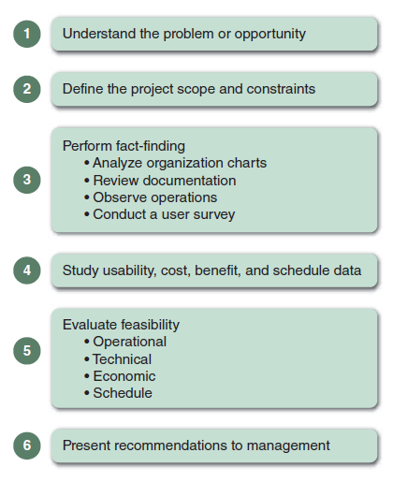
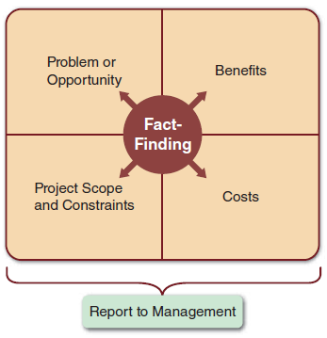
Preliminary Investigation Overview
FIGURE 2-12 Model of a preliminary
investigation. Note the importance of fact-finding in each of the four areas.
FIGURE 2-13 Six main steps in a
typical preliminary investigation.

Slide 48
Preliminary Investigation Overview
Step 1
  Understand the Problem or Opportunity
  Develop a business profile that describes business processes and functions
  Understand how modifications will affect business operations and other information systems
  Determine which departments, users, and business processes are involved
  Systems request may not reveal an underlying problem

Slide 49
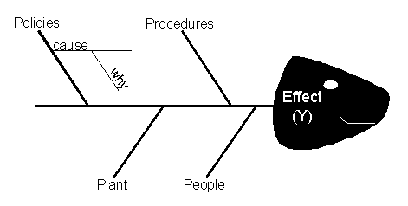
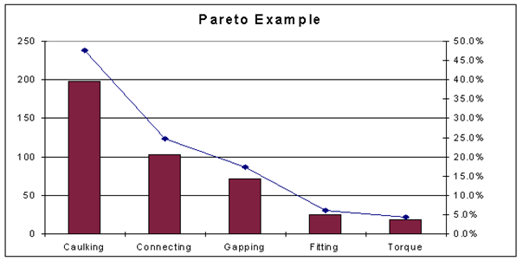






Preliminary Investigation Overview
Step 1
  Understand the Problem or Opportunity
  A popular technique for investigating causes and effects is called a fishbone diagram, or Ishikawa diagram
  Pareto chart

Slide 50




Preliminary Investigation Overview
Step 2
  Define the Project Scope and Constraints
  Define the specific boundaries, or extent, of the project
  Define project scope by creating a list with sections called
    Must Do, Should Do, Could Do, and Won’t Do
  Define project scope as clearly as possible to avoid project creep
  Identify Constraints

Slide 51




Preliminary Investigation Overview
Step 2
  Define the Project Scope and Constraints
  Project scope
    means defining the specific boundaries, or extent, of the project.
    Example:
      a statement that, payroll is not being produced accurately is very general, compared with the statement, overtime pay is not being calculated correctly for production workers on the second shift at the Yorktown plant

Slide 52
Preliminary Investigation Overview
Step 2
  Define the Project Scope and Constraints
  Project creep
    Projects with very general scope definitions are at risk of expanding gradually, without specific authorization, in a process called project creep.
    To avoid this problem, project scope should be defined as clearly as possible

Slide 53
Preliminary Investigation Overview
Step 2
  Define the Project Scope and Constraints
  Constraint
    Requirement or condition that the system must satisfy or an outcome that the system must achieve. System constraints also define project scope.
    A constraint can involve hardware, software, time, policy, law, or cost. Other examples of constraints are:
      The order entry system must accept input from 15 remote sites.
      The human resources information system must produce statistics on hiring practices.
      The new website must be operational by March 1.

Slide 54
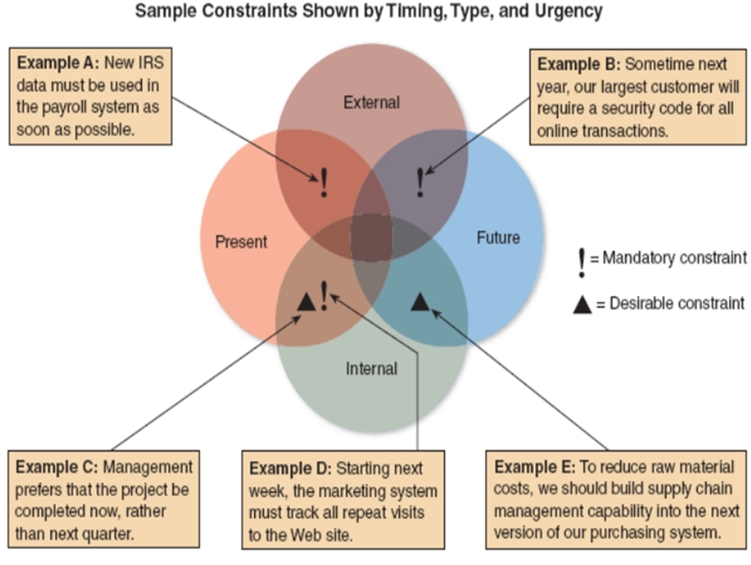
Preliminary Investigation Overview
Step 2
  Define the Project Scope and Constraints
  Constraint cont.
FIGURE 2-15 Examples of various types of constraints.

Slide 55
Preliminary Investigation Overview
Step 2
  Define the Project Scope and Constraints
  Constraint cont.
    Present versus future
      Is the constraint something that must be met as soon as the system is developed or modified, or is the constraint necessary at some future time?
    Internal versus external
      Is the constraint due to a requirement within the organization, or does some external force, such as government regulation, impose it?
    Mandatory versus desirable
      Is the constraint mandatory? Is it absolutely essential to meet the constraint, or is it merely desirable?
    Regardless of the type, all constraints should be identified as early as possible to avoid future problems and surprise

Slide 56


Preliminary Investigation Overview
Step 2
  Define the Project Scope and Constraints
  Objective;
    Objective of an activity, project or procedure represents the output or what you want to accomplish by doing it.
  Scope;
    Scope of an activity, project or procedure represents their limitations or defines the boundaries of its application.
Objective:
To analyze {current process / of ...... ordering /registration in company name}
To design …... a registration system for student …...
To develop a web-based information system for managing tuition registration process

Slide 57
Preliminary Investigation Overview
Step 3
  Perform Fact-Finding
  Gather data about project usability, costs, benefits, and schedules
  Fact-finding involves various techniques
  Depending on what information is needed to investigate the systems request, fact-finding might consume several hours, days, or weeks
  Analyze Organization Charts
    Obtain organization charts to understand how the department functions and identify individuals you might want to interview

Slide 58

Preliminary Investigation Overview
Step 3
  Perform Fact-Finding
  Conduct interviews
    The primary method of obtaining information during the preliminary investigation is the interview. The steps:
      Determine the people to interview.
      Establish objectives for the interview.
      Develop interview questions.
      Prepare for the interview.
      Conduct the interview.
      Document the interview.
      Evaluate the interview.

Slide 59





Preliminary Investigation Overview
Step 3
  Perform Fact-Finding
  Review documentation
    Investigate the current system documentation
    Check with users to confirm that you are receiving accurate and complete information

Slide 60

Preliminary Investigation Overview
Step 3
  Perform Fact-Finding
  Observe operations
    Observe the current system
    See how workers carry out typical task
    Trace or follow the actual paths taken by input source documents or output reports.
FIGURE 2-20 Sometimes, an analyst can get a better understanding of a system by watching actual operations

Slide 61
Preliminary Investigation Overview
Step 3
  Perform Fact-Finding
  Conduct a user survey
    A survey is not as flexible as a series of interviews, but it is less expensive, generally takes less time, and can involve a broad cross-section of people
  Analyze the Data
    Systems analyst might use a Pareto chart
    Analysts may use an XY chart to identify if there is a correlation of variables

Slide 62

Preliminary Investigation Overview
Step 4
  Analyze Project Usability, Cost, Benefit and Schedule Data
  Before you can evaluate feasibility, you must analyze this data carefully
  What information must you obtain, and how will you gather and analyze the information?
  What sources of information will you use, and what difficulties will you encounter in obtaining information

Slide 63
Preliminary Investigation Overview
Step 4
  Analyze Project Usability, Cost, Benefit and Schedule Data
  Will you conduct interviews? How many people will you interview, and how much time will you need to meet with the people and summarize their responses?
  Will you conduct a survey? Who will be involved? How much time will it take people to complete it? How much time will it take to prepare it and tabulate the results?
  How much will it cost to analyze the information gathered and to prepare a report with findings and recommendations?

Slide 64
Preliminary Investigation Overview
Step 5
  Evaluate Feasibility
  Operational feasibility
      Review of user needs, requirements, and expectations
      Look for areas that might present problems for system users and how they might be resolved
  Technical feasibility
      Identify the hardware, software, and network resources needed to develop, install, and operate the system
      Develop a checklist that will highlight technical costs and concerns
  Economic feasibility
      Apply the financial analysis tools
      The cost-benefit data will be important
  Schedule feasibility
      Apply the financial analysis tools
      The cost-benefit data will be important

Slide 65
Preliminary Investigation Overview
Step 6
  Present Results and Recommendations to Management
  The final task in the preliminary investigation is to prepare a report to management
  The format of the preliminary investigation report varies from one company to another
    Introduction
    Systems request summary
    Findings
    Recommendations
    Project Roles
    Time & Cost Estimates
    Expected Benefits
    Appendix

Slide 66
Chapter Summary
Systems planning is the first phase of the systems development life cycle.
A business case should describe the project clearly, provide the justification to proceed, and estimate the project’s financial impact.
Various internal and external factors affect systems projects, such as user requests, top management directives, existing systems, the IT department, software and hardware vendors, technology, customers, competitors, the economy, and government

Slide 67
Chapter Summary
Analysts evaluate the systems request and determine whether the project is feasible from an operational, technical, economic, and schedule standpoint
Steps in the preliminary investigation are:
  Understand the problem or opportunity
  Define the project scope and constraints
  Perform fact-finding
  Analyze project usability, cost, benefit, and schedule data
  Evaluate feasibility
  Present results and recommendations to management

Slide 68
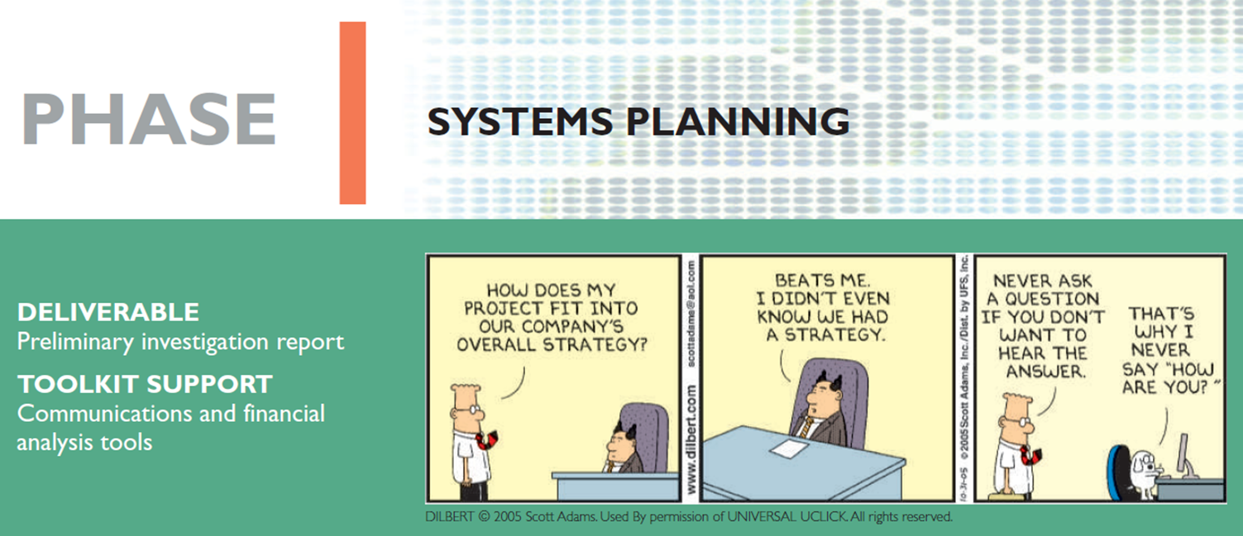


Next Chapter…

